Slide 1


Slide 2

Protect the Front Door: Get started with Identity Protection and Azure MFA
Ronni Pedersen
Microsoft MVP: Enterprise Mobility
APENTO
@ronnipedersen

Slide 3
Protecting Cloud Identities using Azure MFA and EMS
Ronni Pedersen
Microsoft MVP: Enterprise Mobility
APENTO
@ronnipedersen

Slide 4


Ronni Pedersen
Cloud Architect / Partner
APENTO
Microsoft MVP: Enterprise Mobility (11 years)
Founder: System Center User Group Denmark
Microsoft Certified Trainer
Contact Me
Twitter: @ronnipedersen
Blog: https://www.ronnipedersen.com/
Mail: rop@apento.com
Phone: +45 2085 9452
About me...

Slide 5

Agenda
Enterprise Mobility + Security Overview
Microsoft 365 Security and Compliance
Azure AD Privileged Identity Management
Azure AD Identity Protection
Password Policies and Spray Attacks
Multi-factor Authentication
@ronnipedersen

Slide 6
The Vision for the Modern Workplace
@ronnipedersen

Slide 7




What Is Modern Management Really?
Where
ANY
Device
OS
User
@ronnipedersen

Slide 8

The Vision…
A user’s office is
where they work.
@ronnipedersen

Slide 9
Enterprise Mobility + Security
Overview
@ronnipedersen

Slide 10



The world has changed…
@ronnipedersen
10

Slide 11
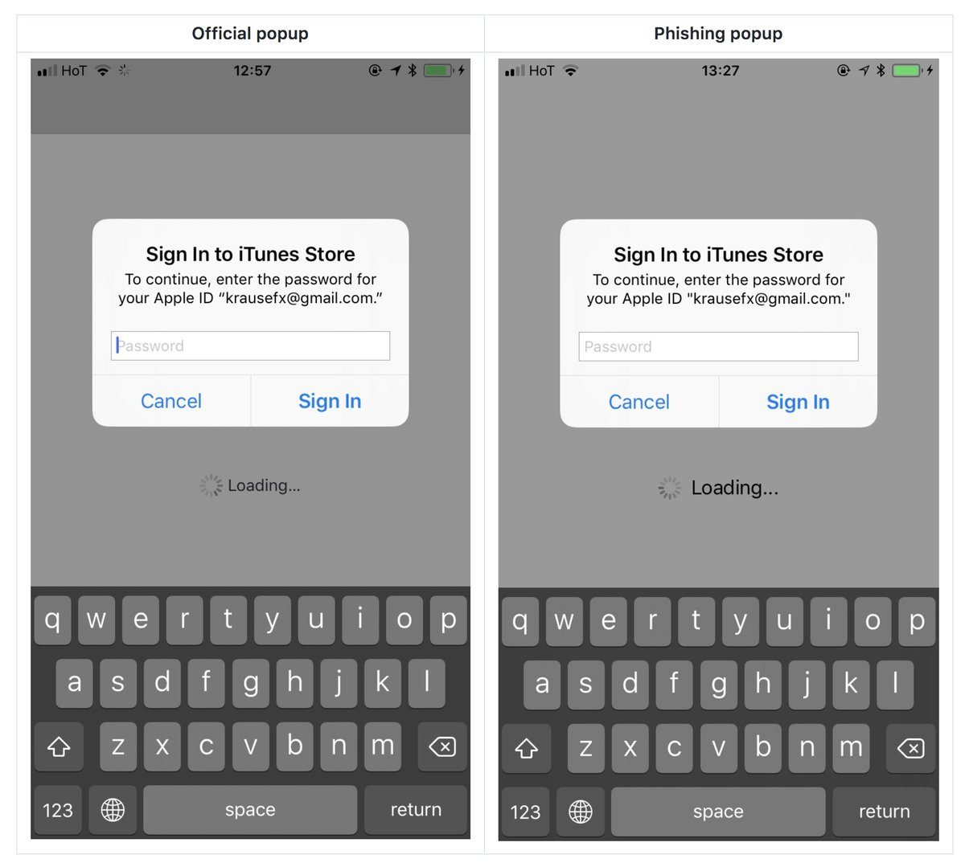
@ronnipedersen

Slide 12
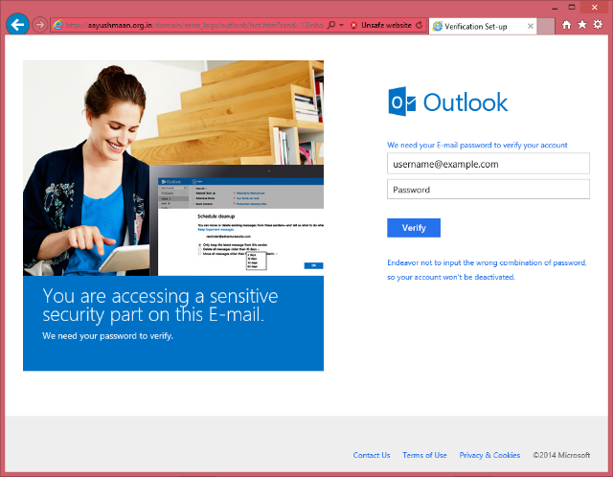
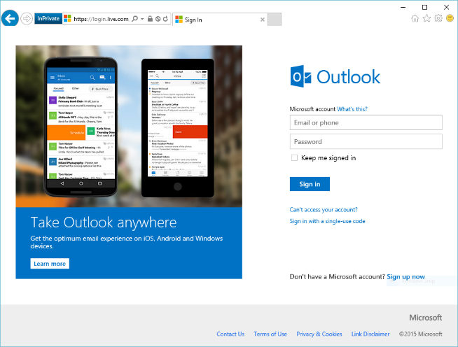
@ronnipedersen

Slide 13
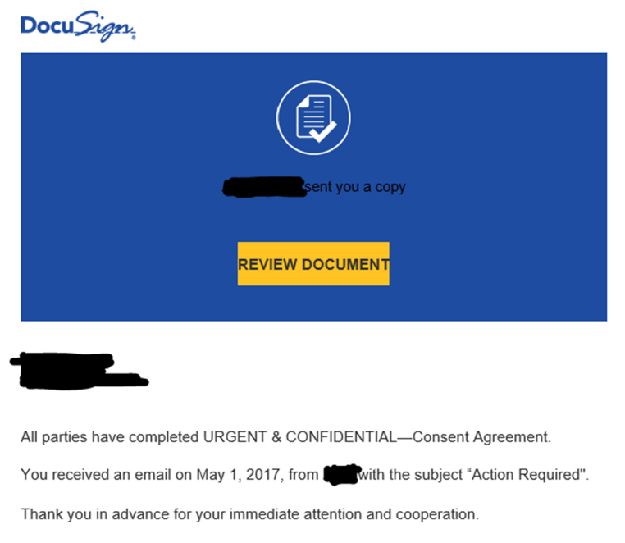
@ronnipedersen

Slide 14
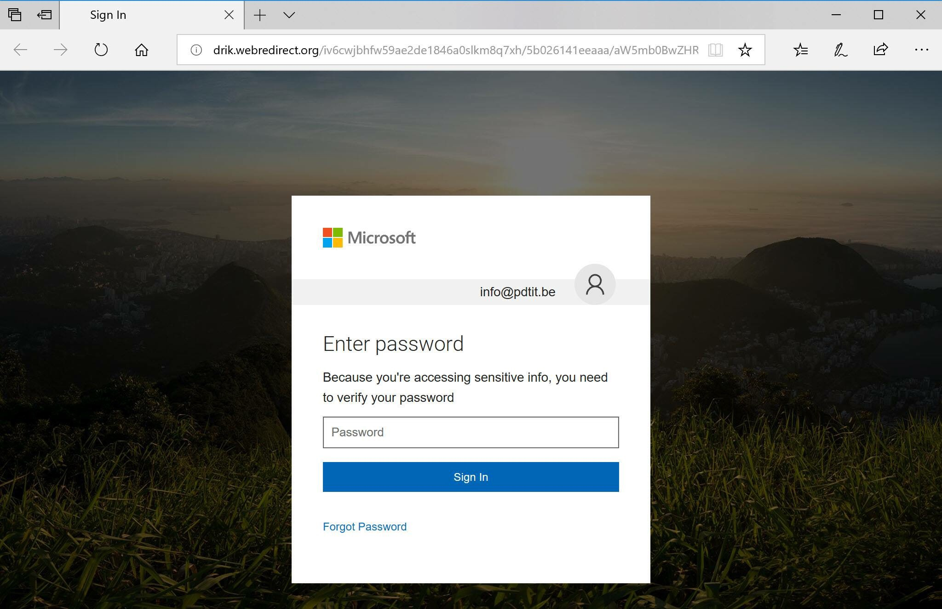
@ronnipedersen

Slide 15
Microsoft 365 Security and Compliance
State of the Union…
@ronnipedersen

Slide 16
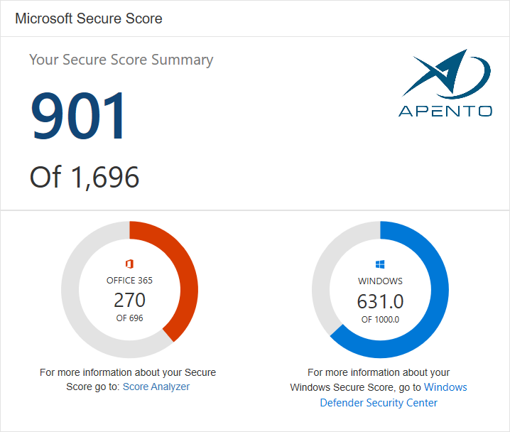
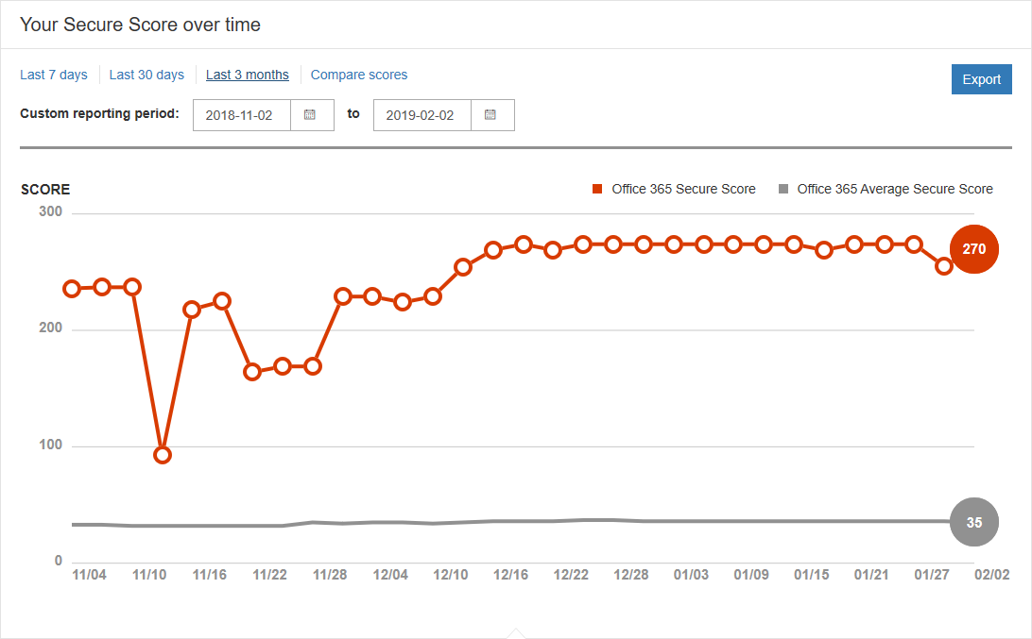
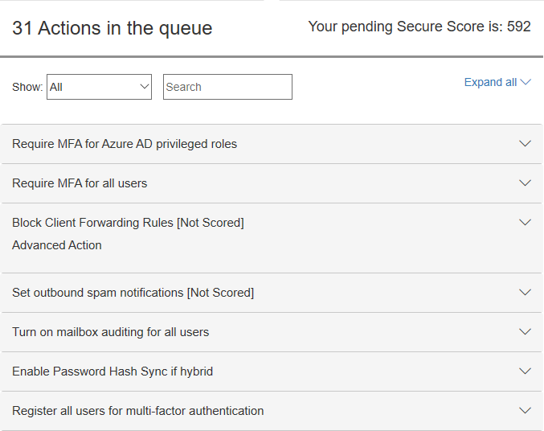
Office 365 Secure Score
Get your Secure Score
Analyzing Your Score
Take Action (Improve Your Score)
@ronnipedersen

Slide 17
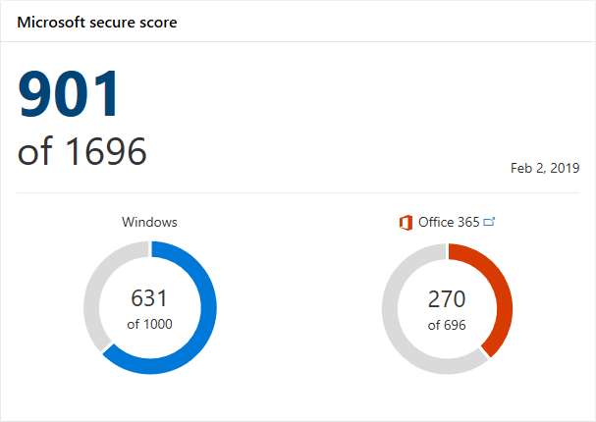
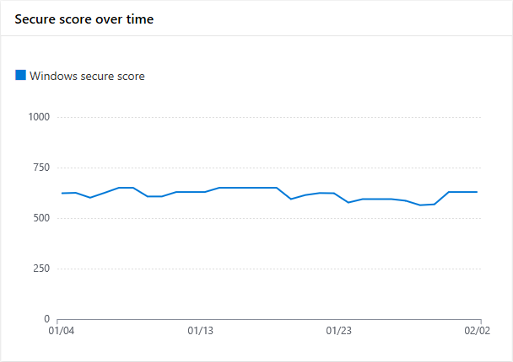
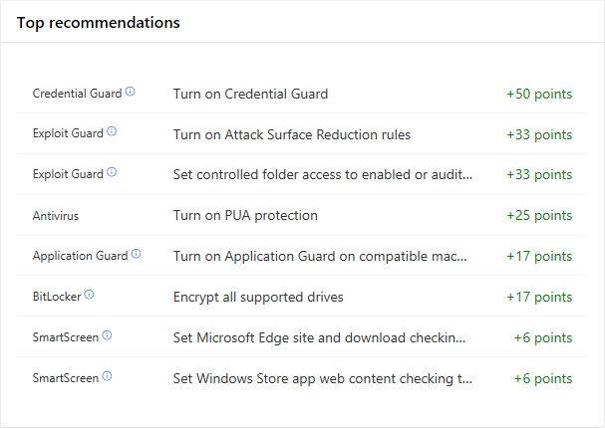
Windows Secure Score
Get the Windows Secure Score
https://securitycenter.windows.com/securescore
Analyze and Take Action!
@ronnipedersen

Slide 18
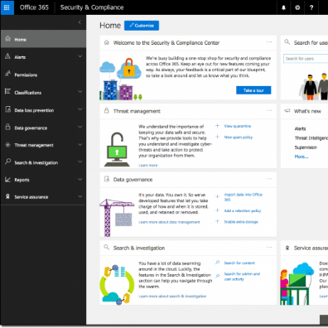
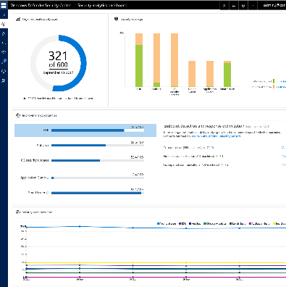
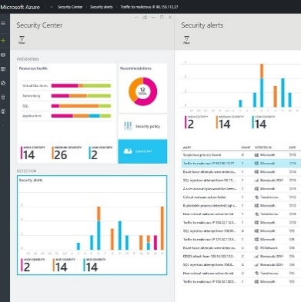
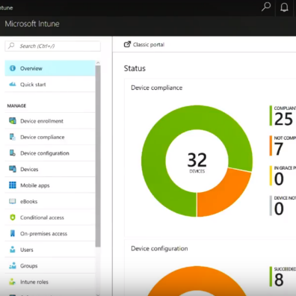
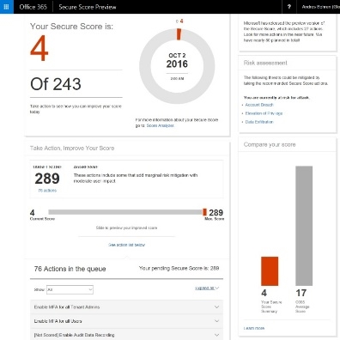
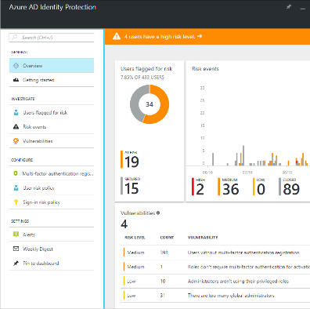
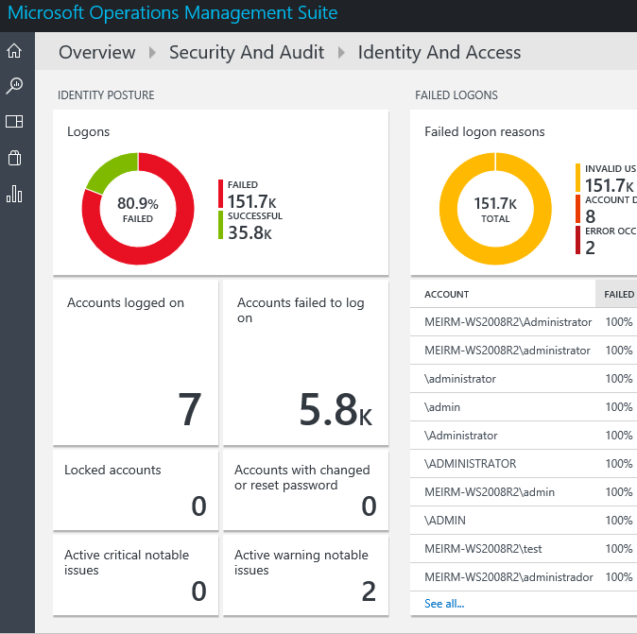
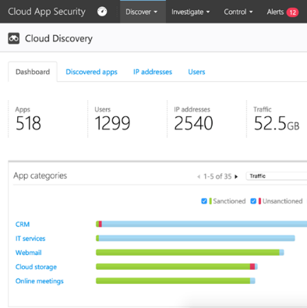
Existing Microsoft products for Security & Compliance
Data/Apps/Email
Office Security & Compliance Center
Devices
Windows Defender ATP
Devices/Network/Apps
Azure Security Center
Devices/Apps
Microsoft Intune
Data/Apps
Office Secure Score
Users
Azure Identity Protection
Devices/Users/Data/Apps
Microsoft OMS
Apps
Cloud app security

Slide 19

ANNONCEMENT (Maybe)
Microsoft 365 Security and Compliance

Slide 20

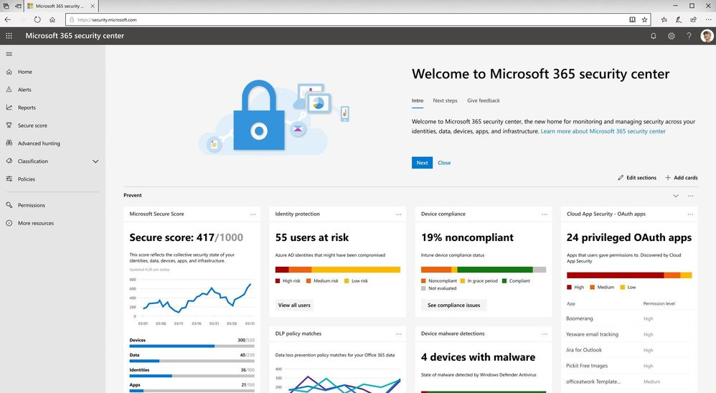
Microsoft 365 Security Center
Visibility Understand the security state and risks across resources.
Control Define consistent security policies and enable controls.
Guidance Elevate security through built-in intelligence and recommendations.
https://security.microsoft.com/
@ronnipedersen

Slide 21

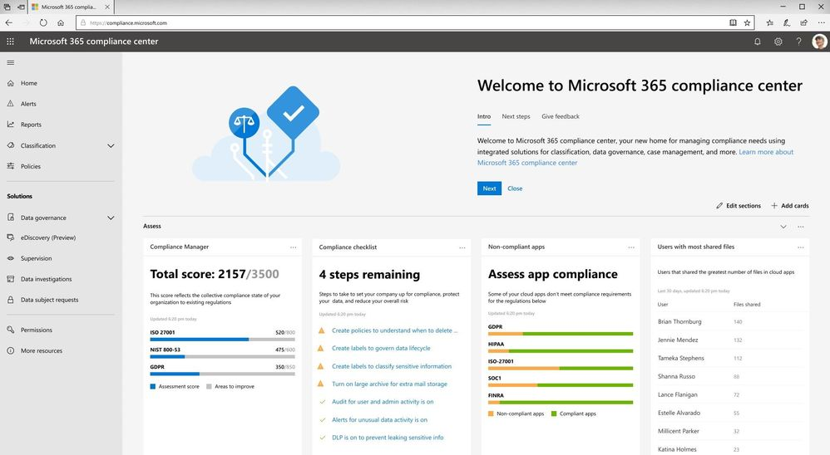
Microsoft 365 Compliance Center
Assess Perform ongoing risk assessments with a compliance score across Microsoft Cloud services.
Protect Automatically classify and protect sensitive data across devices, apps and cloud services.
Respond Efficiently respond to regulatory requests leveraging AI to find the right most relevant data.
https://compliance.microsoft.com/
@ronnipedersen

Slide 22
DEMO
Microsoft Secure Score

Slide 23
Office 365 Secure Score: - Mailbox Auditing in Office 365
Step 1: Connect to Exchange Online
Step 2: Get the current state of audit logging
Step 3: Enable mailbox audit logging
Step 4: Set the age limit for mailbox audit logging
Step 5: Automate the process using Azure Automation
https://www.ronnipedersen.com/2017/07/29/automate-mailbox-auditing-office-365/

Slide 24
Azure AD Privileged Identity Management
Protect the keys to your kingdom
@ronnipedersen

Slide 25

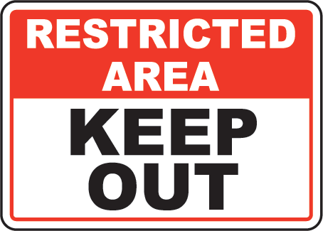


Azure AD Privileged Identity Management
@ronnipedersen

Slide 26
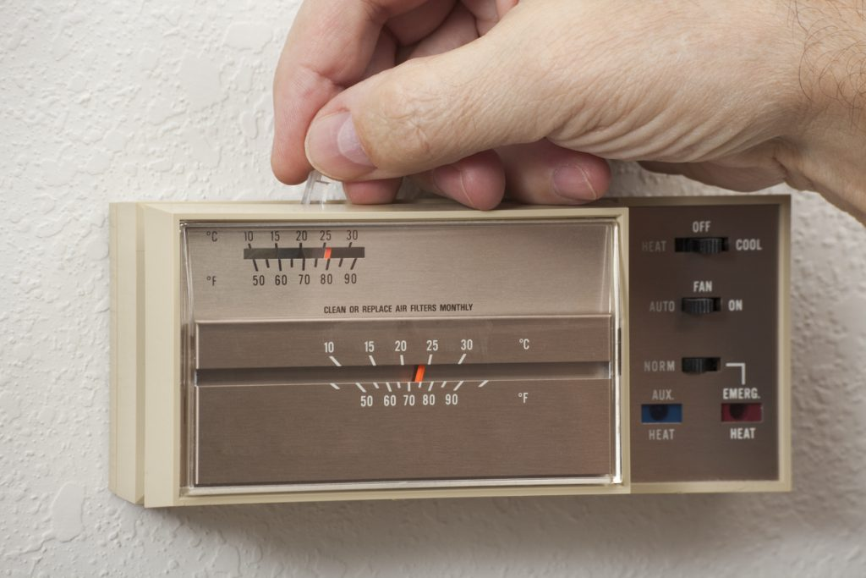
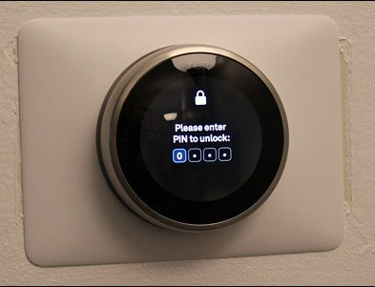
What administration is like
Without PIM
With PIM
@ronnipedersen

Slide 27





Azure AD Privileged Identity Management
Just in Time
Access
Just Enough
Access
Privileged Admin
Workflow
Audit-ready
Protect and control privileged access to your organization

Slide 28
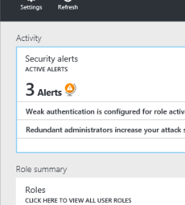
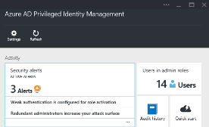
Privileged Identity Management
User
Administrator
Administrator privileges expire after a specified interval
User
Enforce on-demand, just-in-time administrative access when needed
Ensure policies are met with alerts, audit reports and access reviews
Manage admins access in Azure AD and also in Azure RBAC
@ronnipedersen

Slide 29
Get started…
Research
Design
Build
Use
Feedback
Role Based Access Controls
Don’t lock yourself out
Start small and at the top
Create a break-glass account
Get feedback and adjust
Role config & scope, adjust
PIM
@ronnipedersen

Slide 30
DEMO
Azure AD Privileged Identity Management
@ronnipedersen

Slide 31
Azure AD Identity Protection
@ronnipedersen

Slide 32

Risky Sign-in
Low
User sign-in from infected Device
Medium
User sign-in from unfamiliar locations
Impossible travel to atypical location
Sign-in from anonymous IP addresses
High
User with leaked credentials (up for sales)
@ronnipedersen

Slide 33
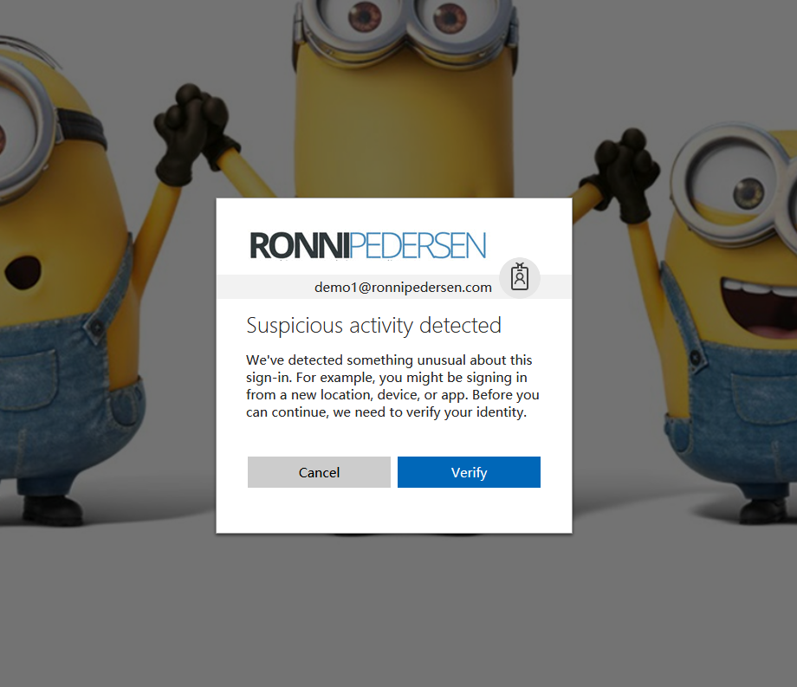
@ronnipedersen

Slide 34
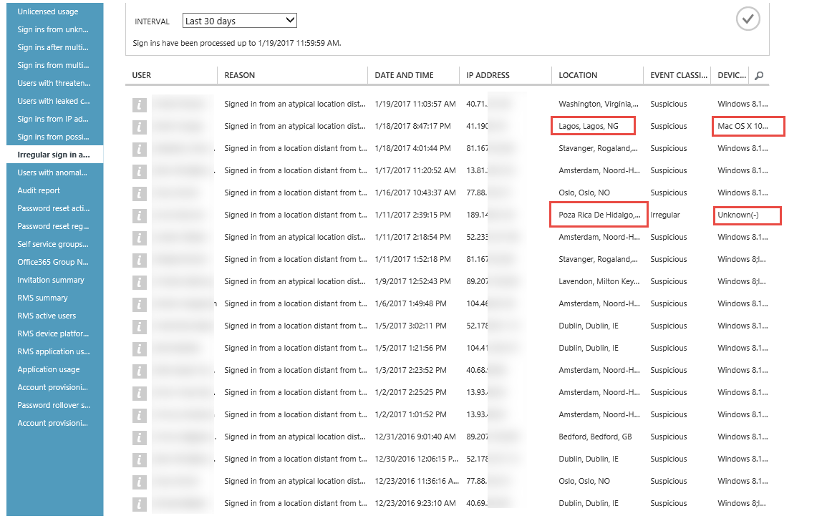
@ronnipedersen

Slide 35
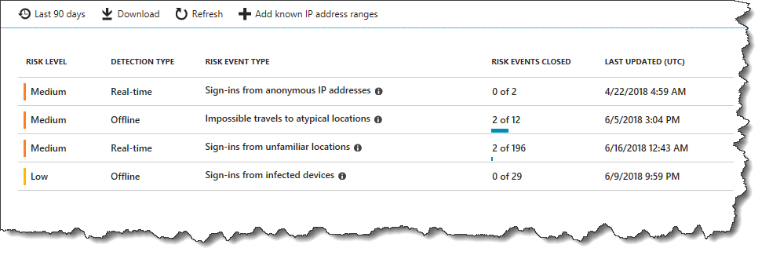
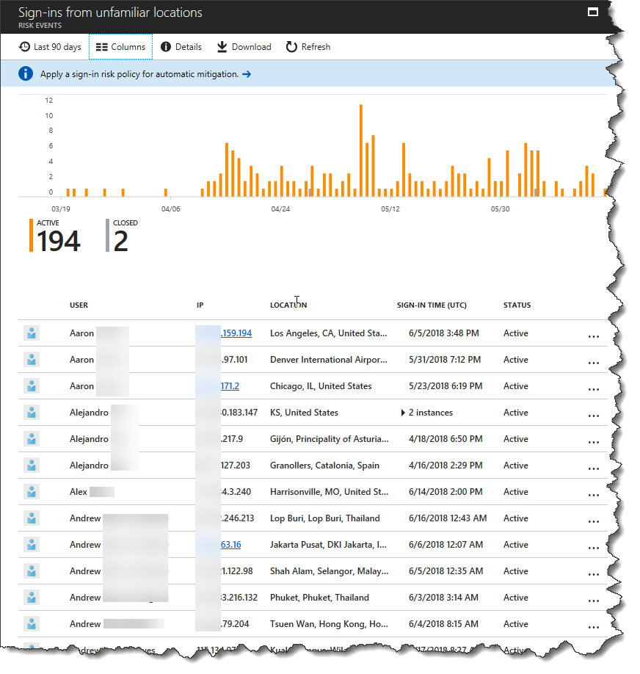
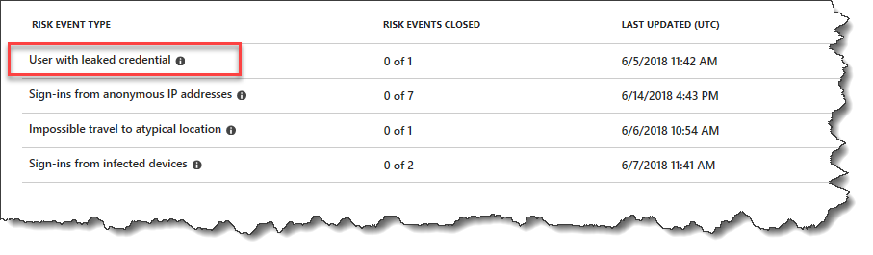
Risky sign-ins / Unfamiliar locations
@ronnipedersen

Slide 36
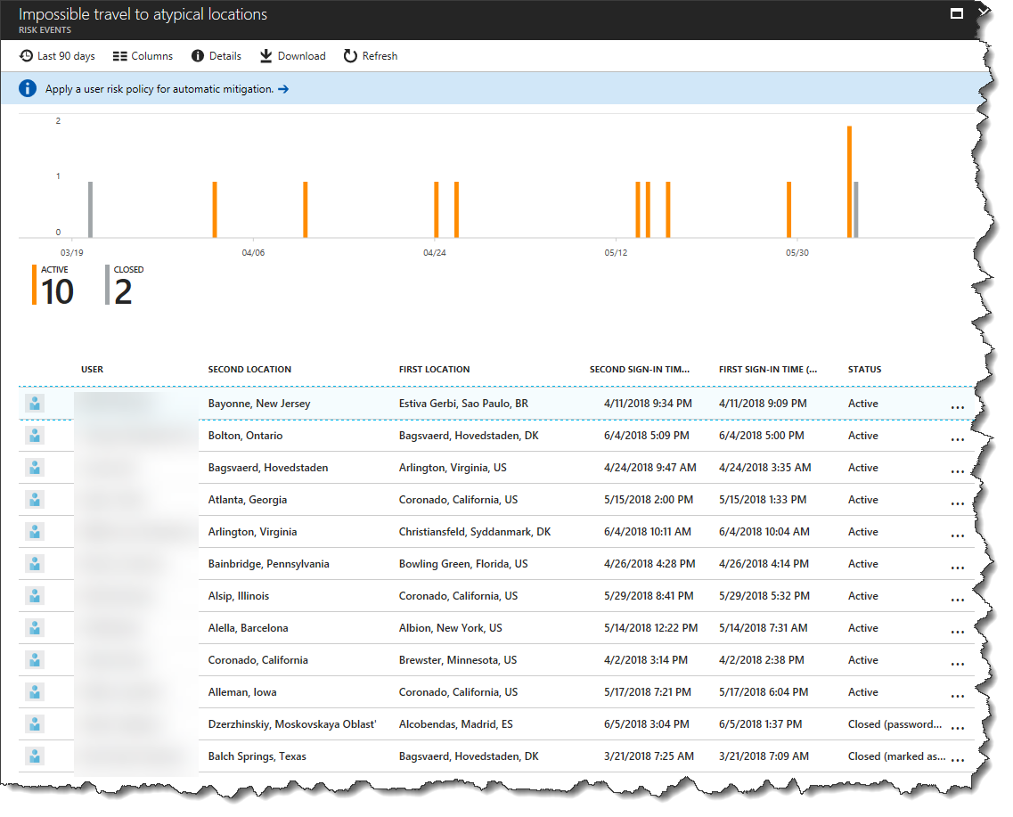
Impossible travel to atypical locations
@ronnipedersen

Slide 37
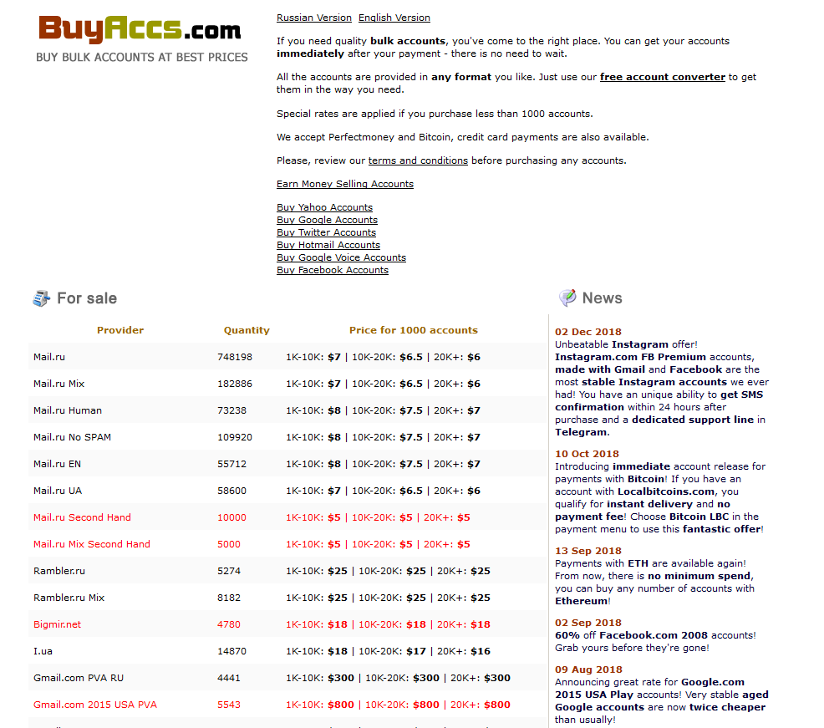
@ronnipedersen

Slide 38
DEMO
Azure AD Identity Protection
@ronnipedersen

Slide 39
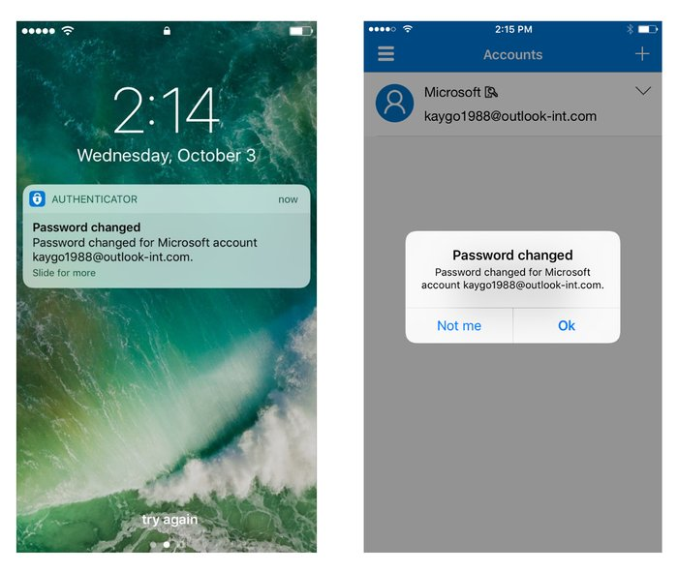
Microsoft Authenticator app now sends security notification (Personal Accounts)
Personal Microsoft Account
Activity Notification
Detect sensitive or unusual actions on your account
Password Change
Adding a new phone number or new email address
Signing in from a new device or unusual location.
@ronnipedersen

Slide 40
Password Policies and Spray Attacks
55.000 Enterprise Accounts hacked by spray attacks (September 2018)
@ronnipedersen

Slide 41
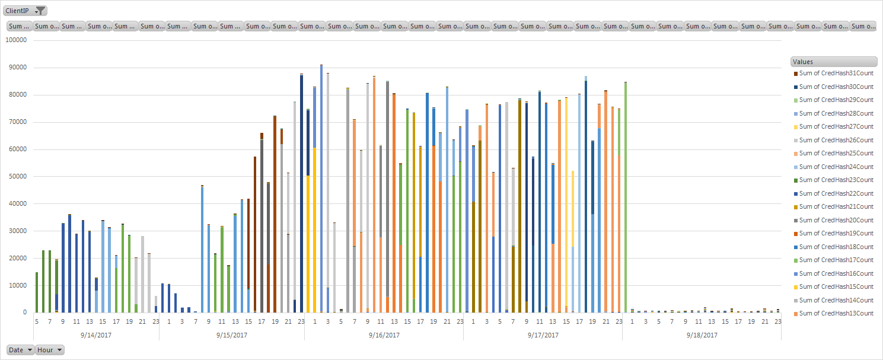
Password Spray (aka Brute Force)
123456
123456789
qwerty
111111
12345678
123123
password
1234567
12345
1234567890
abc123
123
123321
password1
qwertyuiop
666666
a123456
1234
654321
5201314
@ronnipedersen

Slide 42
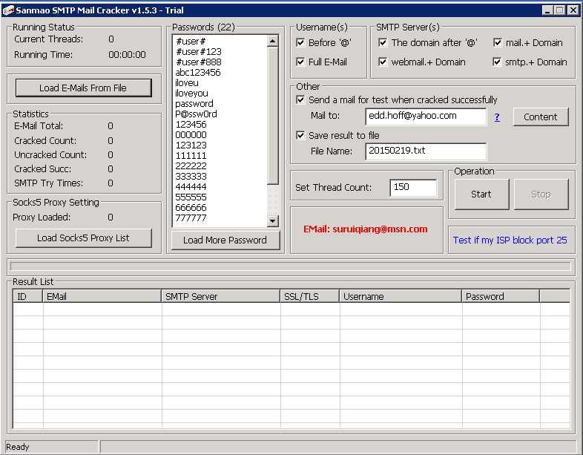
@ronnipedersen

Slide 43
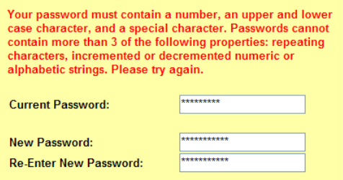
Password complexity requirements don’t help
Most people use similar patterns (i.e. capital letter in the first position, a symbol in the last, and a number in the last two).
Example: Copenh@gen47
Cybercriminals run their dictionary attacks using the common substitutions, such as "$" for "s", "@" for "a," "1" for "l" and so on.
@ronnipedersen

Slide 44
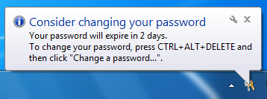
Password expiry does more harm than good
Users who are required to change their passwords frequently select weaker passwords to begin with.
Users do not choose a new independent password; rather, they choose an update of the old one.
Example:
Copenh@gen42
Copenh@gen43
Copenh@gen44
@ronnipedersen

Slide 45
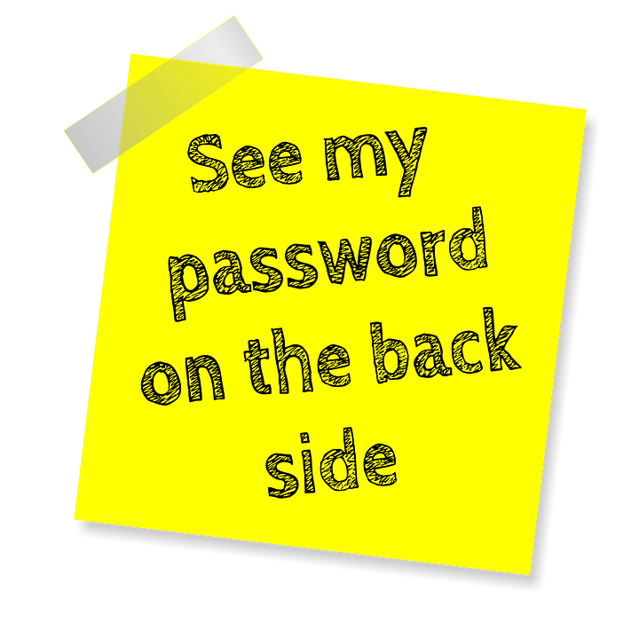
Longer passwords are not necessarily better
Users who are required to have a 16-character password tend to choose repeating patterns like fourfourfourfour or passwordpassword.
Length requirements increase the chance of users:
Writing their passwords down
Re-using passwords
Storing them unencrypted on their PC
@ronnipedersen

Slide 46
Password Protection
If you still want to change them…
@ronnipedersen

Slide 47
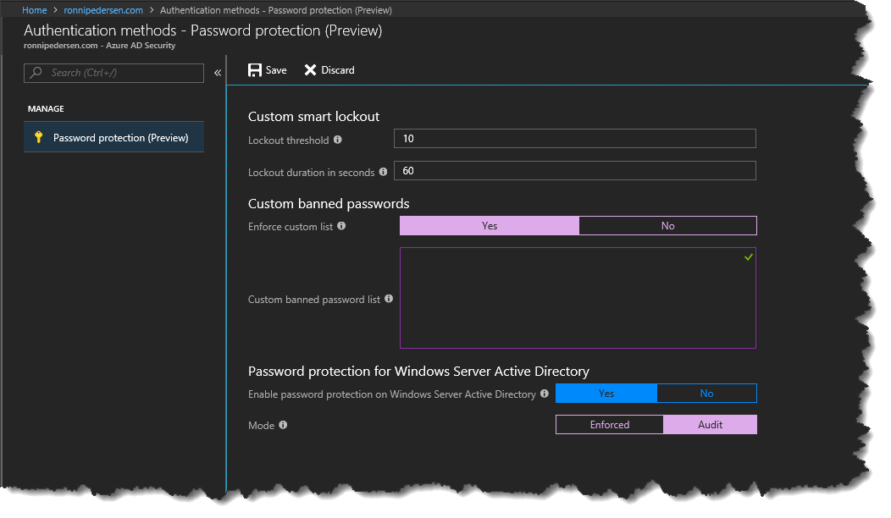
Azure AD Password protection
Custom Smart Lock
Custom Banned Password
Company Name
Brands
Trademarks
Cities
Common character (o for 0)
Case Insensitive
Up to 1000 words
Password Protection for Windows Server Active Directory
https://aka.ms/AADhybridpasswordprotection
Mode: Enforced / Audit
@ronnipedersen

Slide 48
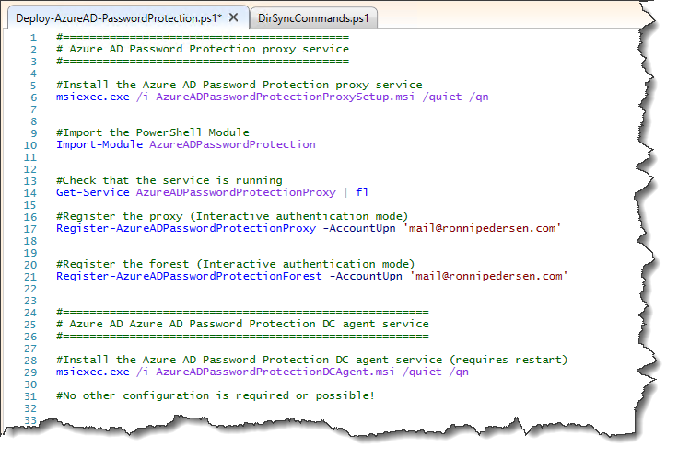
Azure AD Password Protection Deployment
Deployment strategy
Start in audit mode
Deployment requirements
Domain Controllers must be running Windows Server 2012 or later
Azure AD Password Protection Proxy service must Windows Server 2012 R2 or later.
@ronnipedersen

Slide 49
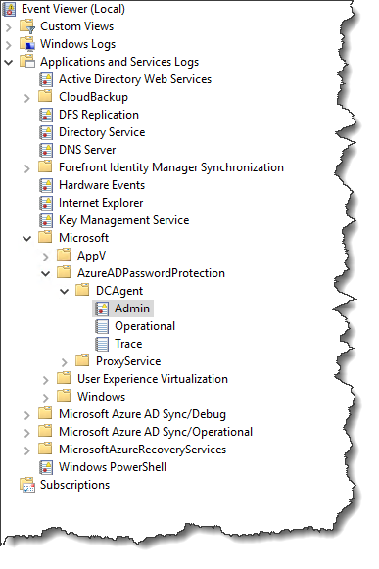
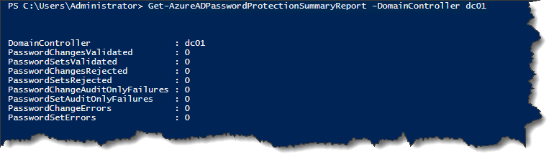
Protection monitoring and logging
DC agent event logging
\Applications and Services Logs\Microsoft\AzureADPasswordProtection\DCAgent\Admin
\Applications and Services Logs\Microsoft\AzureADPasswordProtection\DCAgent\Operational
\Applications and Services Logs\Microsoft\AzureADPasswordProtection\DCAgent\Trace
Password validation summary reporting via PowerShell
Get-AzureADPasswordProtectionSummaryReport -DomainController dc01
@ronnipedersen

Slide 50
DEMO
Azure AD Password protection
@ronnipedersen

Slide 51
Password Hash Sync
Password Hash != Password
You don’t have to change your authentication flow
You get Leaked Credentials Report as part of Azure AD P2
If everything goes down, this might end up saving your job
Turn on Password Hash Sync!
Turn on Seamless SSO
@ronnipedersen

Slide 52
Multi-factor Authentication
Protect the front door…
@ronnipedersen

Slide 53

Modern Authentication
Modern Authentication is the key to success when activating MFA !!!
Turned off for Exchange Online by default.
Turned on for SharePoint Online by default.
Turned off for Skype for Business Online by default.
ON for Tenants created after 1/1-2018
OFF = App Password (Bad End User Experience)
Enable modern authentication for Skype for Business Online
https://www.ronnipedersen.com/2017/07/11/enable-modern-authentication-for-skype-for-business-online/
@ronnipedersen

Slide 54

Modern Authentication - Exchange Online
Enables authentication features like
Multi-factor authentication (MFA) using smart cards
Certificate-based authentication (CBA)
Third-party SAML identity providers
Modern authentication is based on the ADAL and OAuth 2.0
Set-OrganizationConfig -OAuth2ClientProfileEnabled $true
@ronnipedersen

Slide 55
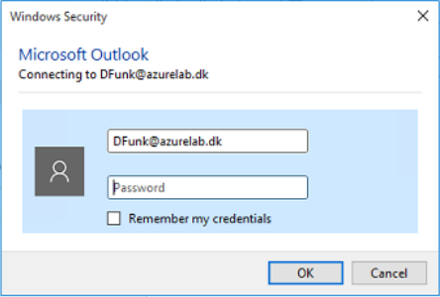
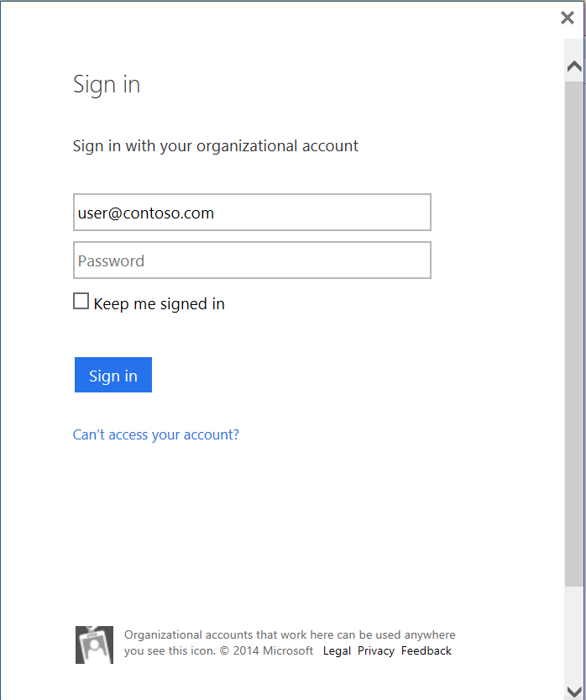
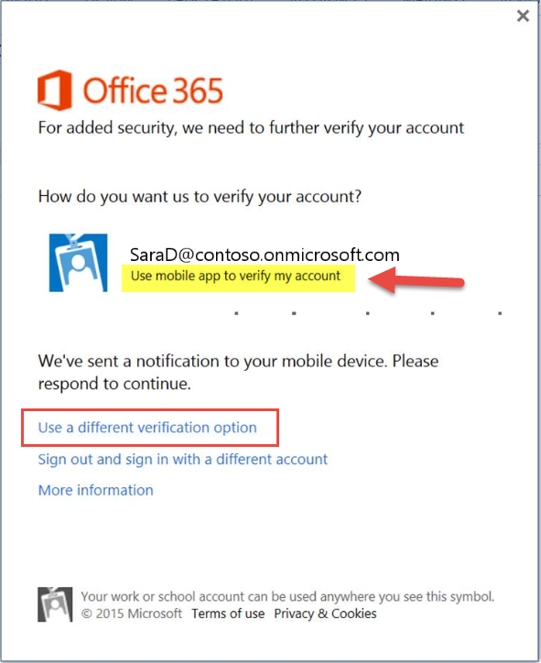
Basic vs. Modern Authentication

Slide 56
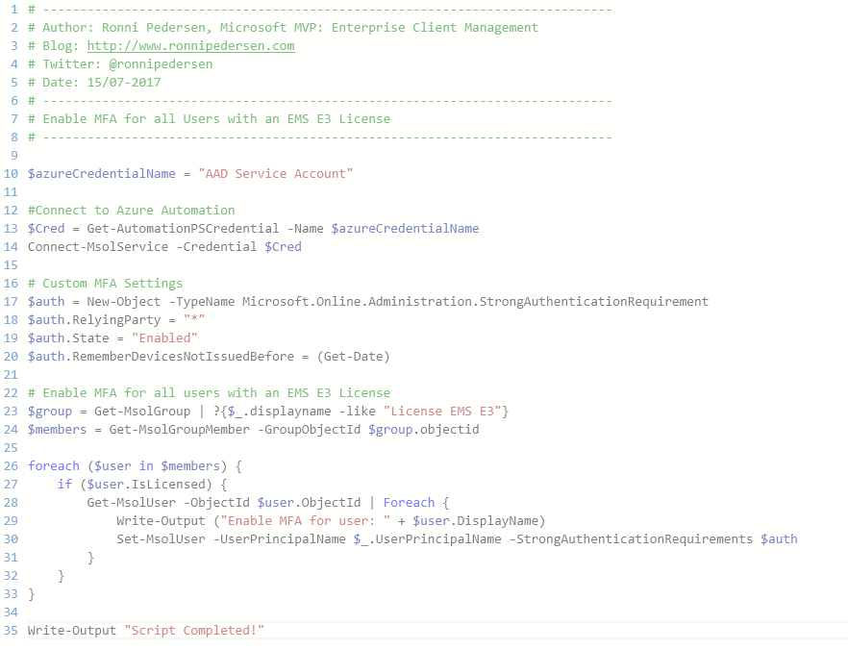
Azure Automation (Runbook) - Enable Azure MFA
Runbook Overview
Connect to the Tenant
Set Custom MFA Settings
Get all users with a license
Enable MFA for the user
Schedule Recommendation:
Every day

Slide 57
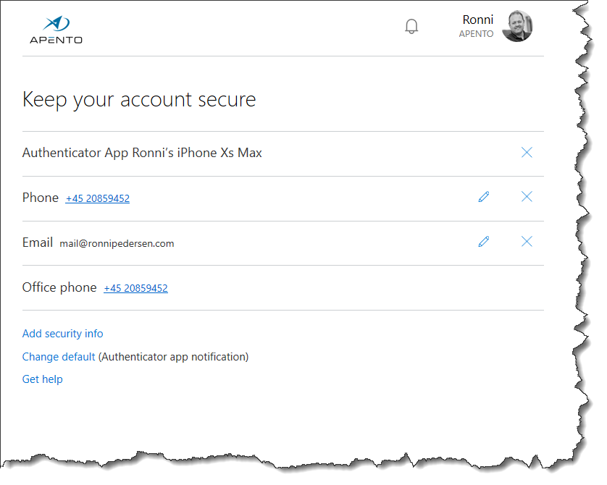
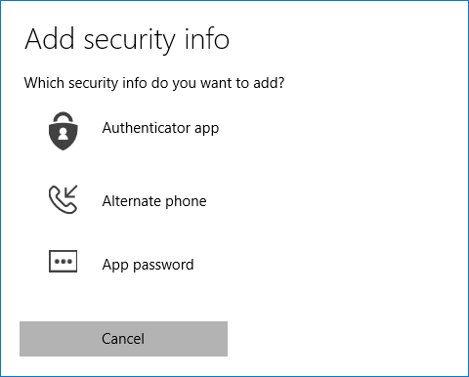
End User MFA Registration
MFA Registration
http://aka.ms/mfasetup

Slide 58
Conditional Access
@ronnipedersen

Slide 59

CYOD, BYOD, Domain Joined
CYOD (Choose your own device)
Personal owned or company owned.
Controlled and managed by company.
BYOD (Bring your own device)
Personal owned. Not controlled by company.
Restrictions to access company information.
Domain joined
Company owned. Controlled by company.
Domain joined + Azure AD device registration
Company owned. Controlled by company.

Slide 60

Device Registration / Compliant
Hybrid Azure AD Joined (DJ++)
Hybrid Identity (Domain Joined + Device Registered in Azure AD)
Azure AD Joined
Cloud Only (Azure AD Joined)
Workplace Joined
”Workgroup” (No Domain or Azure AD Joined)

Slide 61
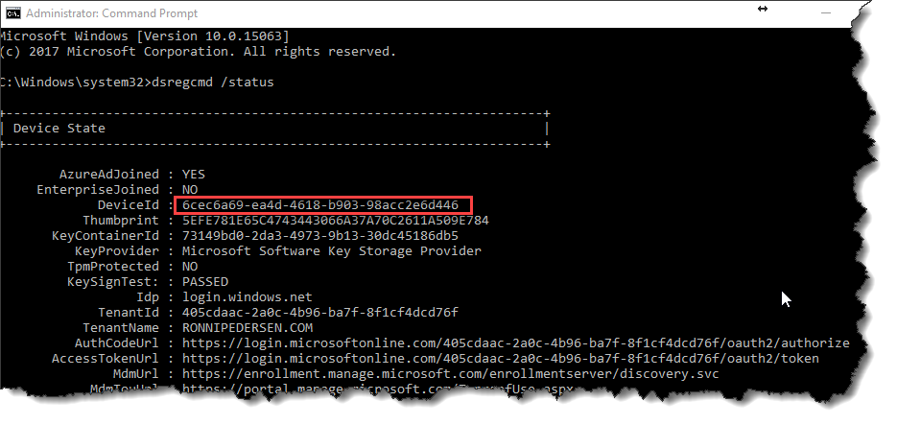
Azure AD Joined
Command: dsregcmd /status
My PC: 6cec6a69-ea4d-4618-b903-98acc2e6d446

Slide 62

Device Trust Type

Slide 63


Enable Azure AD automatic enrollment

Slide 64
Thank you!
© RONNIPEDERSEN.COM
64

Slide 65
Secure Guest Access with Azure MFA
Require MFA using Conditional Access
@ronnipedersen

Slide 66

Identify External Guest Users
Azure AD Group
Dynamic Membership
userType Equals Guest

Slide 67

Conditional Access and Guest Users
All Guest Users (Preview)

Slide 68


Require MFA for Guest Users
Conditional Access Rule
All Guest Users
Microsoft Teams
Require MFA

Slide 69

Microsoft Teams
Guest sharing is disabled by default
By default you share the entire Team Site
Share a single document with external user can be enabled
https://msunified.net/2018/01/11/share-a-single-document-with-external-user-in-microsoft-teams/

Slide 70



Terms of Use
Guests need to comply with YOUR written policy before accessing data
Can be enforced on first logon or later if changed

Slide 71
Licenses for Guests and B2B users
5:1

Slide 72
Self-Service Password Reset
@ronnipedersen

Slide 73


Self-Service Password Reset
Password Reset Portal
https://passwordreset.microsoftonline.com/
Password reset from Login Screen
OMA-URI ./Vendor/MSFT/Policy/Config/Authentication/AllowAadPasswordReset

